Slide 1
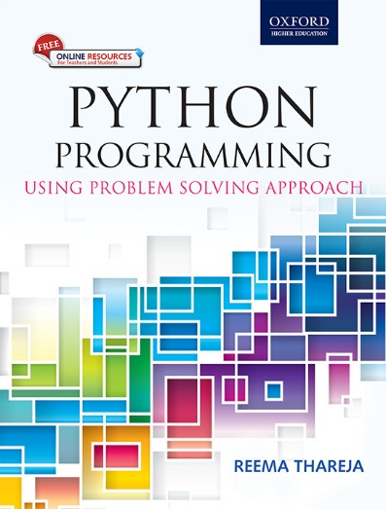
1
Python Programming
Using Problem Solving Approach
Reema Thareja

Slide 2
CHAPTER 9
Classes and Objects
© Oxford University Press 2017. All rights reserved.

Slide 3
Classes and Objects
Classes and objects are the two main aspects of object oriented programming. In fact, a class is the basic building block in Python. A class creates a new type and object is an instance (or variable) of the class. Classes provides a blueprint or a template using which objects are created. In fact, in Python, everything is an object or an instance of some class. For example, all integer variables that we define in our program are actually instances of class int. Similarly, all string variables are objects of class string. Recall that we had used string methods using the variable name followed by the dot operator and the method name. We have already studied that we can find out the type of any object using the type() function.
© Oxford University Press 2017. All rights reserved.

Slide 4



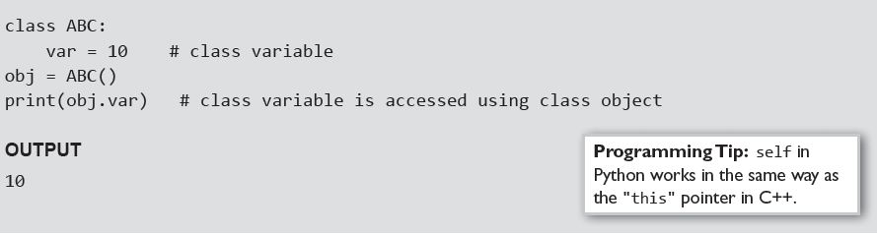
Creating Objects
Once a class is defined, the next job is to create an object (or instance) of that class. The object can then access class variables and class methods using the dot operator (.). The syntax to create an object is given as,
Creating an object or instance of a class is known as class instantiation. From the syntax, we can see that class instantiation uses function notation. Using the syntax, an empty object of a class is created. Thus, we see that
in Python, to create a new object, call a class as if it were a function. The syntax for accessing a class member through the class object is
Example:
© Oxford University Press 2017. All rights reserved.

Slide 5
Data Abstraction and Hiding through Classes
Classes provide methods to the outside world to provide the functionality of the object or to manipulate the object's data. Any entity outside the world does not know about the implementation details of the class or that method.
Data encapsulation, also called data hiding organizes the data and methods into a structure that prevents data access by any function (or method) that is not specified in the class. This ensures the integrity of the data contained in the object.
Encapsulation defines different access levels for data variables and member functions of the class. These access levels specifies the access rights for example,
• Any data or function with access level public can be accessed by any function belonging to any class. This is the lowest level of data protection.
• Any data or function with access level private can be accessed only by the class in which it is declared. This is the highest level of data protection.
© Oxford University Press 2017. All rights reserved.

Slide 6
Class Method And Self Argument
Class methods (or functions defined in the class) are exactly same as ordinary functions that we have been defining so far with just one small difference. Class methods must have the first argument named as self. This is the first argument that is added to the beginning of the parameter list. Moreover, you do not pass a value for this parameter when you call the method. Python provides its value automatically. The self argument refers to the object itself. That is, the object that has called the method. This means that even if a method that takes no arguments, should be defined to accept the self. Similarly, a function defined to accept one parameter will actually take two- self and the parameter, so on and so forth.
Since, the class methods uses self, they require an object or instance of the class to be used. For this reason, they are often referred to as instance methods.
Example:
© Oxford University Press 2017. All rights reserved.

Slide 7
The __init__() Method (The Class Constructor)
The __init__() method has a special significance in Python classes. The __init__() method is automatically executed when an object of a class is created. The method is useful to initialize the variables of the class object. Note the __init__() is prefixed as well as suffixed by double underscores.
Example:
© Oxford University Press 2017. All rights reserved.

Slide 8
Class Variables And Object Variables
Basically, these variables are of two types- class variables and object variables. Class variables are owned by the class and object variables are owned by each object. What this specifically means can be understood using following points.
• If a class has n objects, then there will be n separate copies of the object variable as each object will have its own object variable.
• The object variable is not shared between objects.
• A change made to the object variable by one object will not be reflected in other objects.
If a class has one class variable, then there will be one copy only for that variable. All the objects of that class will share the class variable.
• Since there exists a single copy of the class variable, any change made to the class variable by an object will be reflected to all other objects.
© Oxford University Press 2017. All rights reserved.

Slide 9
Class Variables And Object Variables - Example
© Oxford University Press 2017. All rights reserved.

Slide 10
The __del__() Method
The __del__() method does just the opposite work. The __del__() method is automatically called when an object is going out of scope. This is the time when object will no longer be used and its occupied resources are returned back to the system so that they can be reused as and when required. You can also explicitly do the same using the del keyword.
Example:
© Oxford University Press 2017. All rights reserved.

Slide 11
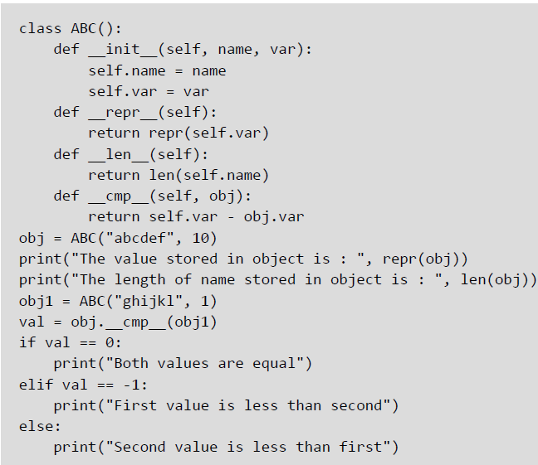
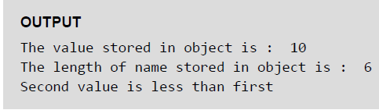
Other Special Methods
• __repr__(): __ The __repr__() function is a built-in function with syntax repr(object). It returns a string representation of an object. The function works on any object, not just class instances.
• __cmp__(): The __cmp__() function is called to compare two class objects.
• __len__(): The __len__() function is a built-in function that has the syntax, len(object). It returns the length of an object.
Example:
© Oxford University Press 2017. All rights reserved.

Slide 12
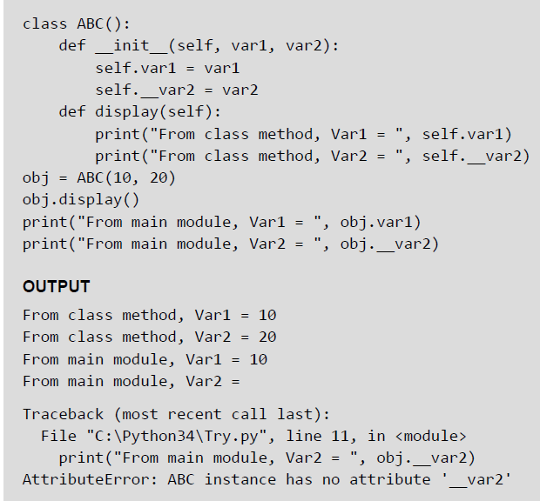
Public and Private Data Members
Public variables are those variables that are defined in the class and can be accessed from anywhere in the program, of course using the dot operator. Private variables, on the other hand, are those variables that are defined in the class with a double score prefix (__). These variables can be accessed only from within the class and from nowhere outside the class.
Example:
© Oxford University Press 2017. All rights reserved.

Slide 13
Private Methods
Like private attributes, you can even have private methods in your class. Usually, we keep those methods as private which have implementation details. So like private attributes, you should also not use private method from anywhere outside the class. However, if it is very necessary to access them from outside the class, then they are accessed with a small difference. A private method can be accessed using the object name as well as the class name from outside the class. The syntax for accessing the private method in such a case would be. objectname._classname__privatemethodname
Example:
© Oxford University Press 2017. All rights reserved.

Slide 14
Calling a Class Method from Another Class Method
Example:
© Oxford University Press 2017. All rights reserved.

Slide 15
Built-in Functions To Check, Get, Set And Delete Class Attributes
hasattr(obj,name): The function is used to check if an object possess the attribute or not.
getattr(obj, name[, default]): The function is used to access or get the attribute of object. Since getattr() is a built-in function and not a method of the class, it is not called using the dot operator. Rather, it takes the object as its first parameter. The second parameter is the name of the variable as a string, and the optional third parameter is the default value to be returned if the attribute does not exist. If the attribute name does not exist in the object's namespace and the default value is also not specified, then an exception will be raised. Note that, getattr(obj, 'var') is same as writing obj.var. However, you should always try to use the latter variant.
setattr(obj,name,value): The function is used to set an attribute of the object. If attribute does not exist, then it would be created. The first parameter of the setattr() function is the object, the second parameter is the name of the attribute and the third is the new value for the specified attribute.
delattr(obj, name): The function deletes an attribute. Once deleted, the variable is no longer a class or object attribute.
© Oxford University Press 2017. All rights reserved.

Slide 16
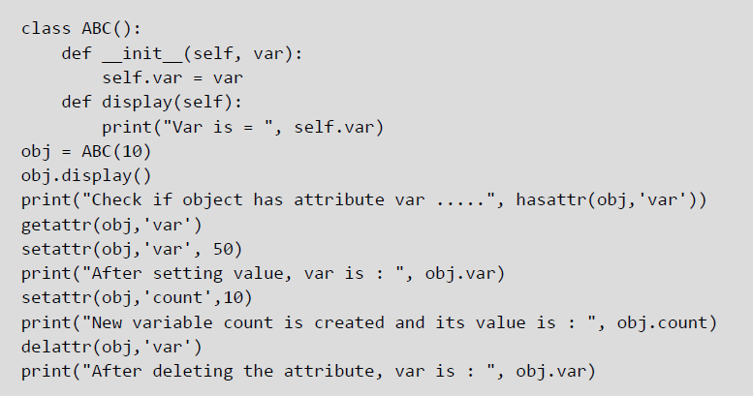

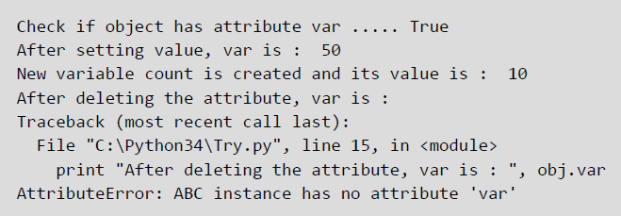
Built-in Functions - Example
© Oxford University Press 2017. All rights reserved.

Slide 17
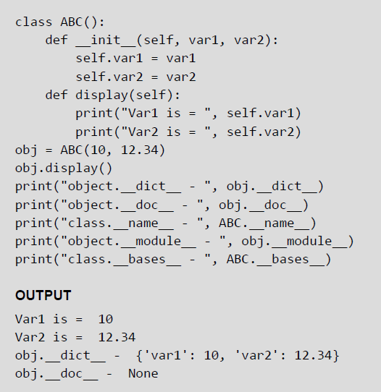
Built-in Class Attributes
.__dict__: The attributes gives a dictionary containing the class's or object's (with whichever it is accessed) namespace.
.__doc__: The attribute gives the class documentation string if specified. In case the documentation string is not specified, then the attribute returns None.
.__name__: The attribute returns the name of the class.
.__module__: The attribute gives the name of the module in which the class (or the object) is defined.
.__bases__: Used in inheritance to return the base classes in the order of their occurrence in the base class list.
Example:
© Oxford University Press 2017. All rights reserved.

Slide 18
Garbage Collection (Destroying Objects)
Python performs automatic garbage collection. This means that it deletes all the objects (built-in types or user defined like class objects) automatically that are no longer needed and that have gone out of scope to free the memory space. The process by which Python periodically reclaims unwanted memory is known as garbage collection.
Python's garbage collector runs in the background during program execution. It immediately takes action (of reclaiming memory) as soon as an object's reference count reaches zero. For example,
© Oxford University Press 2017. All rights reserved.

Slide 19
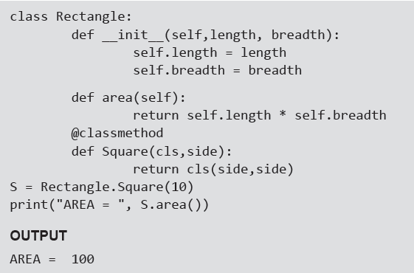
Class Methods
Class methods are little different from these ordinary methods. First, they are called by a class (not by instance of the class). Second, the first argument of the classmethod is cls not the self.
Class methods are widely used for factory methods, which instantiate an instance of a class, using different parameters than those usually passed to the class constructor.
Example:
© Oxford University Press 2017. All rights reserved.

Slide 20
Static Methods
Any functionality that belongs to a class, but that does not require the object is placed in the static method. Static methods are similar to class methods. The only difference is that a static method does not receive any additional arguments. They are just like normal functions that belong to a class.
A static method does not use the self variable and is defined using a built-in function named staticmethod. Python has a handy syntax, called a decorator, to make it easier to apply the staticmethod function to the method function definition. The syntax for using the staticmethod decorator.
© Oxford University Press 2017. All rights reserved.

Slide 21

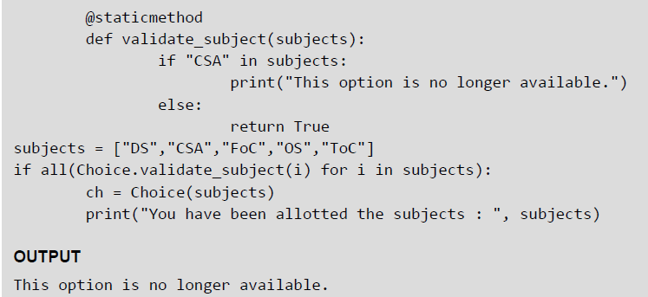
Static Methods — Example
© Oxford University Press 2017. All rights reserved.

